Slide 1
Bangladesh Army University of Science and Technology
Dpt:CSE

Slide 2
Catch The Ball (Android apk) Team: Backspace
Project Mentor:
Abu Saleh Musa Miah
Lecturer
Department of CSE
BAUST
Team Members:
Antar Sarker(170201056)
Abir Hassan(170201063)
Md. Moshaheb Hossain(170201047)

Slide 3
Content:
Introduction
Uses
Objectives
Mockup Design
Explanation Of Features
Social Impact

Slide 4
Introduction:
Android is a Linux based operating system , designed primarily for touch screen mobile devices . These applications are more comfortable and advanced for the users.
Catch the ball is an android game . Here user(player) needs to catch the right balls to gain point and go on . Catching wrong ball will end the game.
The official language for Android development, Java will be used to build this game application. And using xml for app interface..

Slide 5
Uses:
Mobile applications frequently serve to provide users with similar services to those accessed on PCs.
A mobile game is a game played on a feature phone, smartphone/tablet, smart watch, PDA, portable media player or graphing calculator. The earliest known game on a mobile phone was a Tetris variant on the Hagenuk MT-2000 device from 1994.
Video games have a number of ingredients that are very powerful for brain plasticity, learning, attention or vision.

Slide 6
Game Objectives:
Capture/destroy: Eliminate all balls coming towards you in the game.
Territorial control: The focus is not necessarily on catching the ball, but on controlling certain areas of the board. RISK and Diplomacy are examples.
Chase/race/escape : Generally, anything where you are running towards or away from something. Here it means to escape from wrong balls.
Build : The opposite of “destroy” — your goal is to build your point.

Slide 7
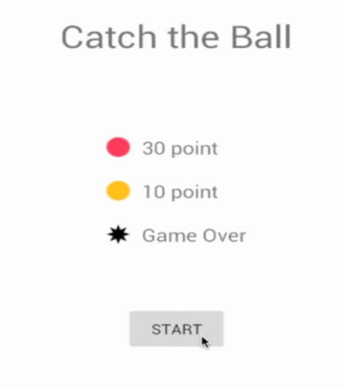
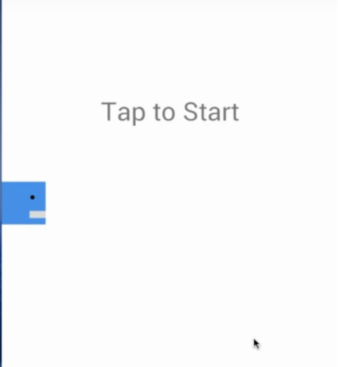
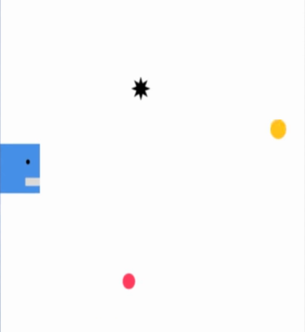
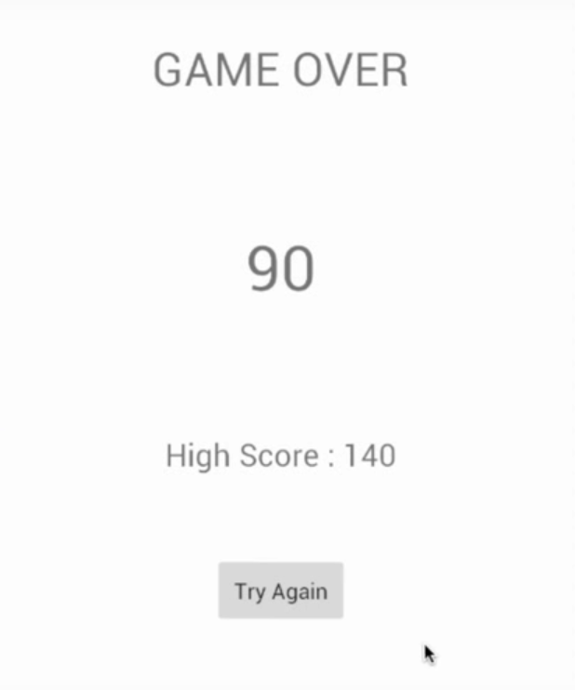
Interface look
Startup View:
Game View:
End View:

Slide 8
Explanation Of Features:
Startup: User can easily startup a game with out facing any difficulties.(ex. login must , advertisement etc.)
Gameplay: Ball catching points or effects will be notified to the player on the startup page.
Points: Player can see his/her gained point at the time of playing.
Game Over: Catching wrong ball(here black colored balls) will end the game, and player will be notified with his/her gained point and last highest score.
Restart Options: Player can restart directly from the game over screen.
Feature Update: We will try to add new feature for developing our project in future..

Slide 9
Social Impact :
The effect of video games on the brain is very similar to the effect of wine on the health: there are some very poor uses of wine, there are some very poor uses of video games . It vastly depends on user.
If user use the game on right purpose, make use of it on leisure time, this will help the users brain to think and process fast.
Impact on society will depend on peoples wants and using system.
This game won’t going to force users stay or hurt them on any state.

Slide 10
THANK YOU ALL.

